Slide 1

職場故事 (Animaze)
Notes:
Video by <a href="https://pixabay.com/videos/ai-generated-man-woman-laptop-205691/">Mohamed Hassan</a> from <a href="https://pixabay.com//?utm_source=link-attribution&utm_medium=referral&utm_campaign=video&utm_content=62891">Pixabay</a>
大家好，我今天要來分享我的DJ職場故事

Slide 2
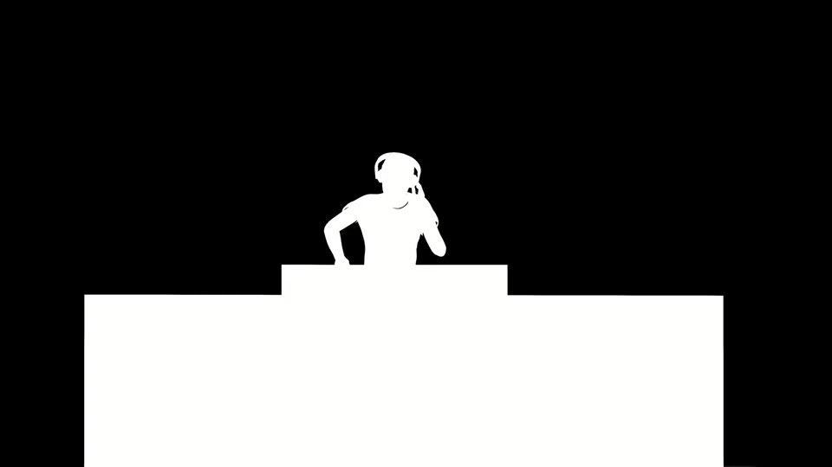
1. 目標
Notes:
Video by <a href="https://pixabay.com/videos/dj-party-entertainment-headphones-115113/">Mohamed Hassan</a> from <a href="https://pixabay.com//?utm_source=link-attribution&utm_medium=referral&utm_campaign=video&utm_content=123689">Pixabay</a>
我現在是一名專業DJ，並在知名夜店擔任駐場DJ，我的目標是進一步提升知名度，登上更大的舞台，並參加國際音樂節，讓更多人聽見我的音樂。

Slide 3

2. 阻礙
Notes:
Video by <a href="https://pixabay.com/videos/stop-sign-sticker-green-screen-100594/">Christian Bodhi</a> from <a href="https://pixabay.com//?utm_source=link-attribution&utm_medium=referral&utm_campaign=video&utm_content=52430">Pixabay</a>
但行業競爭激烈，想要在眾多才華洋溢的DJ中脫穎而出並不容易。

Slide 4

Notes:
Video by <a href="https://pixabay.com/videos/counseling-therapy-mental-health-147244/">Sami Ullah</a> from <a href="https://pixabay.com//?utm_source=link-attribution&utm_medium=referral&utm_campaign=video&utm_content=202134">Pixabay</a>
而且夜店的觀眾需求多變，常要求迎合流行，讓我發揮創意時感到有壓力。

Slide 5
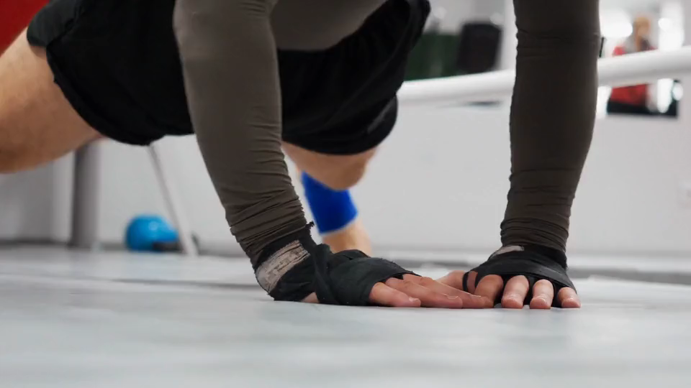
3. 努力
Notes:
Video by <a href="https://pixabay.com/videos/pushups-fitness-exercise-work-out-143431/">ferdster</a> from <a href="https://pixabay.com//?utm_source=link-attribution&utm_medium=referral&utm_campaign=video&utm_content=38959">Pixabay</a>
為了突破，我開始創作更多原創混音作品，並積極上傳到網路，擴展我的粉絲群

Slide 6
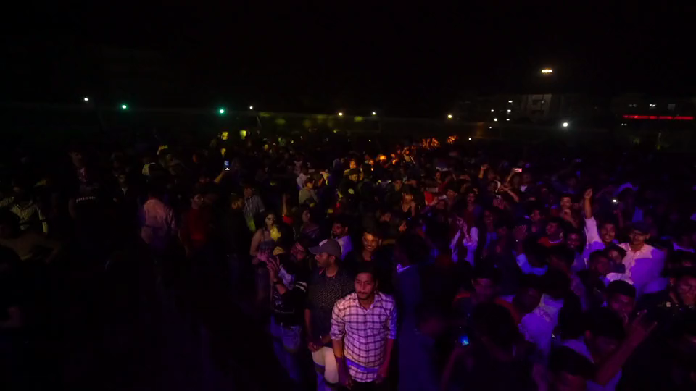
Notes:
Video by <a href="https://pixabay.com/videos/music-festival-people-music-event-41823/>Nans Ceos</a> from <a href="https://pixabay.com//?utm_source=link-attribution&utm_medium=referral&utm_campaign=video&utm_content=27706">Pixabay</a>
我還參加各種音樂活動，與其他音樂人合作，提升技術和創新能力。

Slide 7
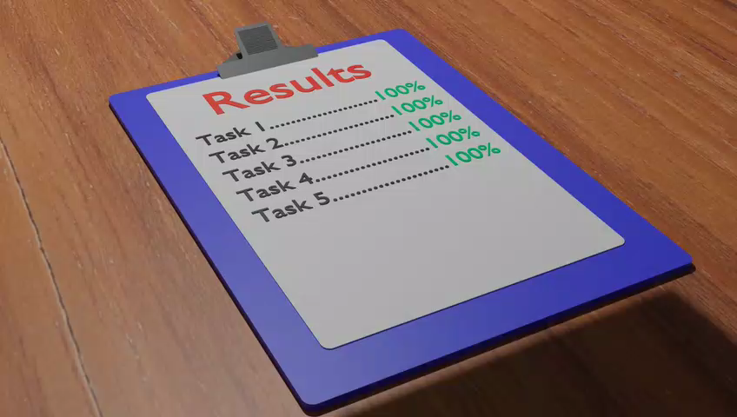
4. 結果
Notes:
Video by <a href=“https://pixabay.com/videos/results-clipboard-competence-133176/">Grant Muller</a> from <a href="https://pixabay.com//?utm_source=link-attribution&utm_medium=referral&utm_campaign=video&utm_content=133176">Pixabay</a>
結果有一次，我在大型音樂派對上表演，原本想展示新作品，卻發現觀眾反應冷淡，讓我有些焦慮。

Slide 8

5. 意外
Notes:
Video by <a href="https://pixabay.com/users/mastertux-470906/?utm_source=link-attribution&utm_medium=referral&utm_campaign=video&utm_content=148301">MasterTux</a> from <a href="https://pixabay.com//?utm_source=link-attribution&utm_medium=referral&utm_campaign=video&utm_content=148301">Pixabay</a>
正當我覺得會失敗時

Slide 9
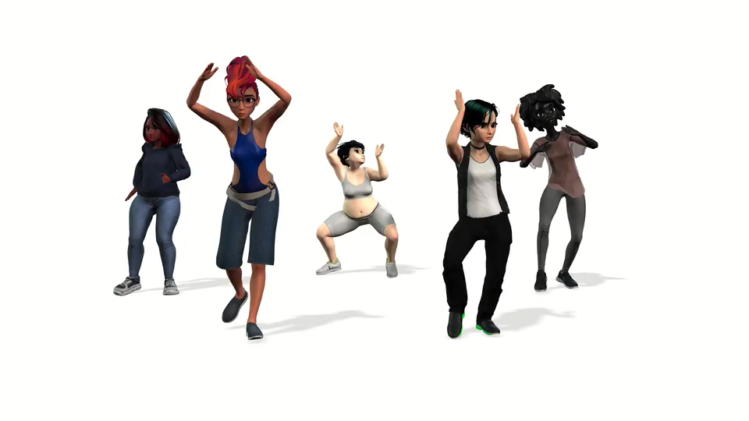
Notes:
Video by <a href="https://pixabay.com/videos/girls-friends-fun-dance-dancing-147099/">Engin Akyurt</a> from <a href="https://pixabay.com//?utm_source=link-attribution&utm_medium=referral&utm_campaign=video&utm_content=44646">Pixabay</a>
一群人開始隨著我的節拍跳舞，逐漸帶動全場，最終現場氣氛變得狂熱，這讓我非常驚喜。

Slide 10

6. 轉彎
Notes:
https://www.videvo.net/video/newspaper-headline-discussing-strike-negotiations-in-trade-union-dispute-5/1799606/#rs=video-box
表演結束後，我收到了來自幾位音樂製作人的聯繫，甚至有國際音樂節主辦方邀請我參加他們的活動

Slide 11

Notes:
Video by <a href="https://pixabay.com/videos/love-valentine-valentines-day-107256/">Mohamed Hassan</a> from <a href="https://pixabay.com//?utm_source=link-attribution&utm_medium=referral&utm_campaign=video&utm_content=69588">Pixabay</a>
我發現堅持自己的風格，比迎合市場更能打動人心。

Slide 12

7. 結局
Notes:
Video by <a href="https://pixabay.com/users/curious_collectibles-11004713/?utm_source=link-attribution&utm_medium=referral&utm_campaign=video&utm_content=33141">Shaun</a> from <a href="https://pixabay.com//?utm_source=link-attribution&utm_medium=referral&utm_campaign=video&utm_content=33141">Pixabay</a>
這次成功激勵我挑戰更多音樂領域，未來我要繼續創作原創音樂，並追求在更大的國際舞台上表演的夢想。

